Slide 1



Hashtag site
PROJECT MADE BY :-
Deepanshi
Reg. no:- 12116416
Section:- KOCO4
Group:- [2]
Roll no-RKOC04B62
Submitted to:
Faculty Name- Pooja Rana

Slide 2

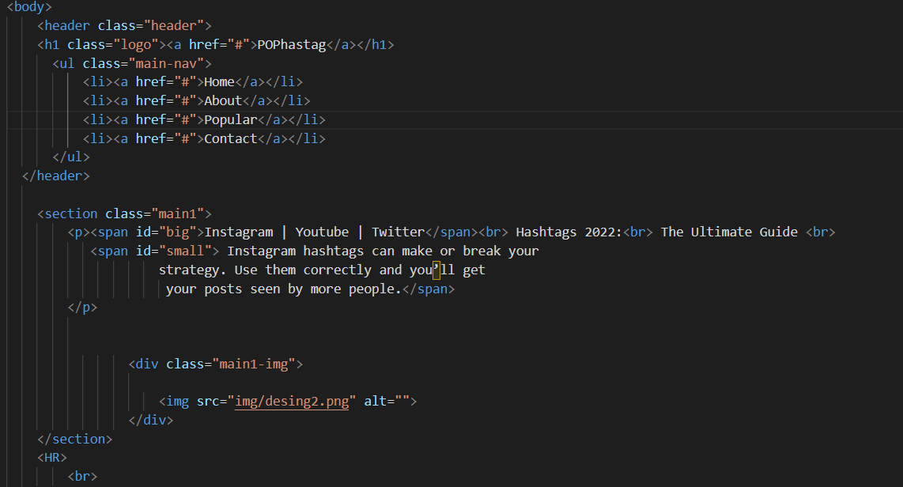
Source code
Source code
Here the user can see topic, sub-topic
Tags used here are :–
Div tag
Style tag
Class
Link tag

Slide 3
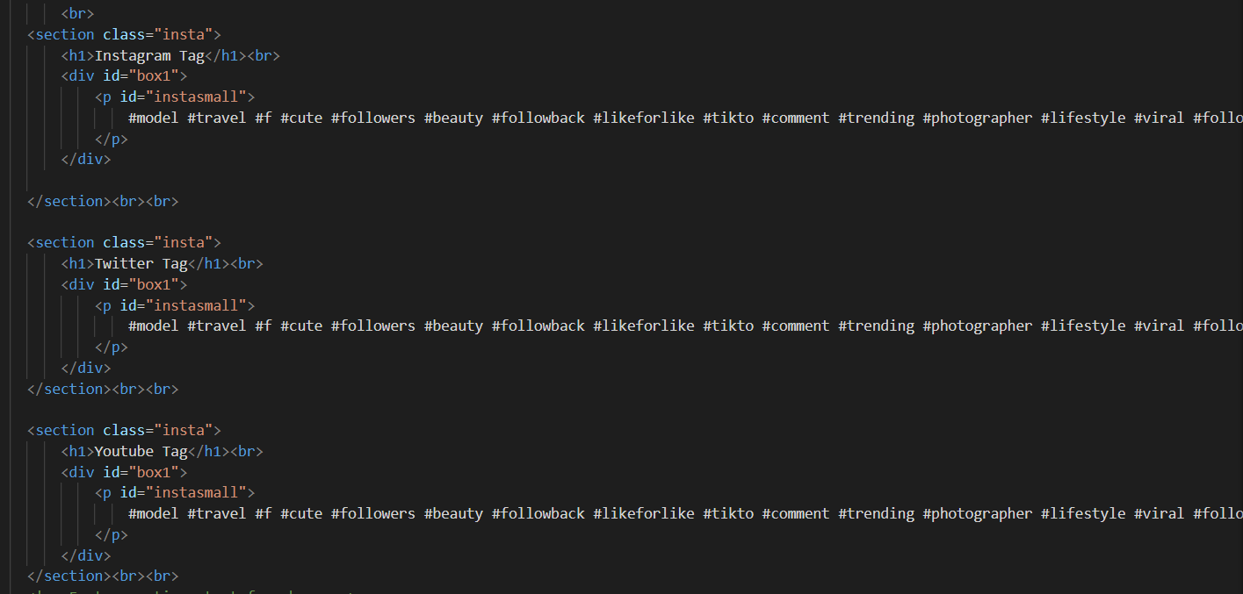
Source code

Slide 4
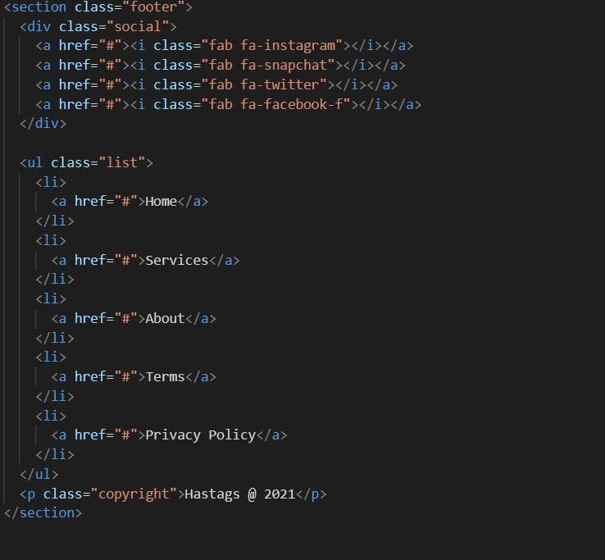
FOOTER HTML

Slide 5

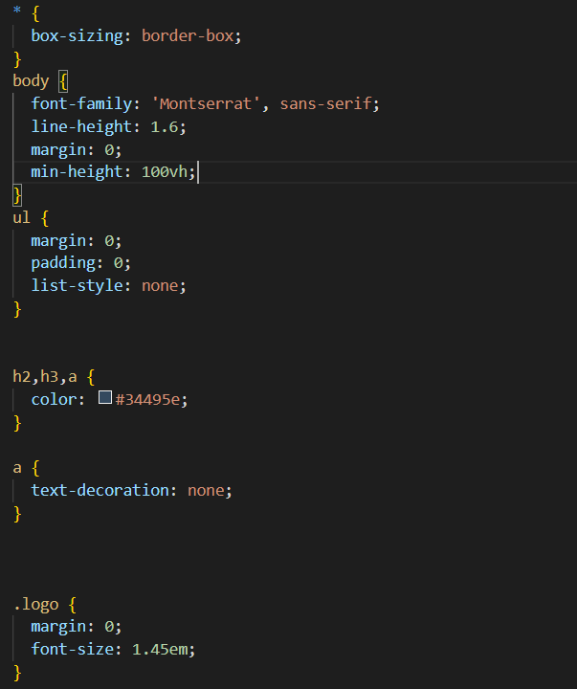
CSS CODE

Slide 6
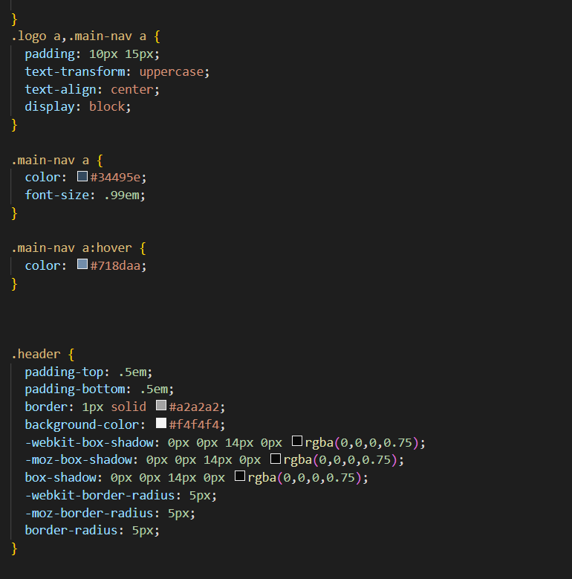
CSS CODE

Slide 7
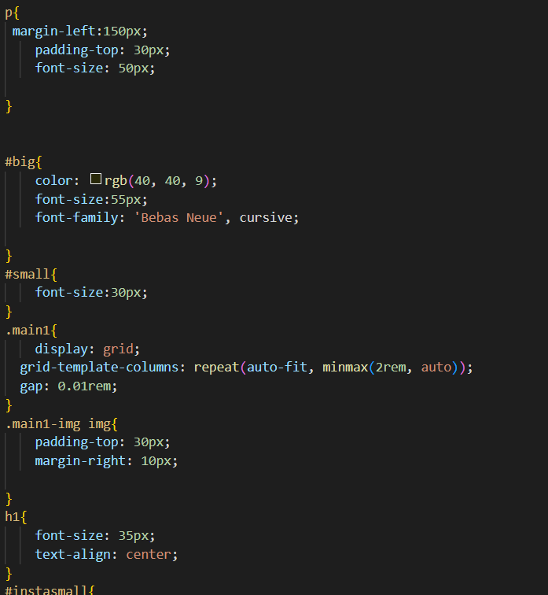
CSS CODE

Slide 8


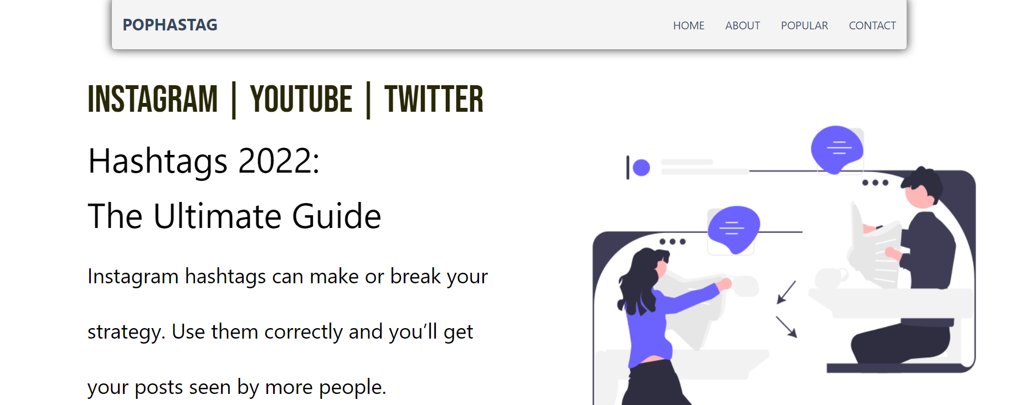
Page overview

Slide 9
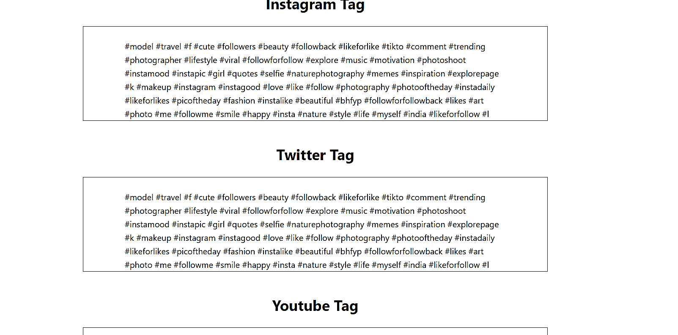

Slide 10



Footer Section
This Photo by Unknown Author is licensed under CC BY-SA-NC

Slide 11

References
Images and logo
Link:- https://unsplash.com/
Link:- https://fontawesome.com/icons
HTML and CSS Help:-
Link:- https://www.w3schools.com/html/ Link:-https://codewithharry.com/

